Slide 1



Determining a Classifier Threshold of NBC
Ben Brobbey, Sierra Freytiz, Drew Mangione, Timothy Wilmes, Maitland Witmer

Slide 2
Agenda
Exploratory learning with Naïve Bayes Classifier
Background on the Project
Our Problem Statement
Materials and Methods Overview
Results and Discussion
Conclusion

Slide 3
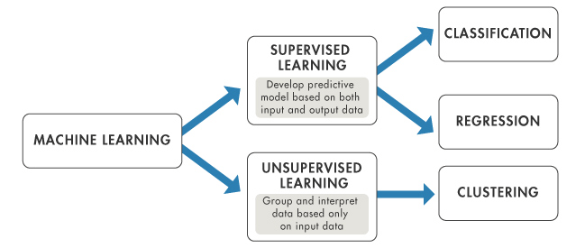
Exploratory Learning
Helps identify the contents of sequences and groups them by feature similarities
i.e. Uses specific information about the general data to classify sequences in their respective groups
Takes in large hierarchal set of categories (super-kingdom, class, phylum, order)

Slide 4
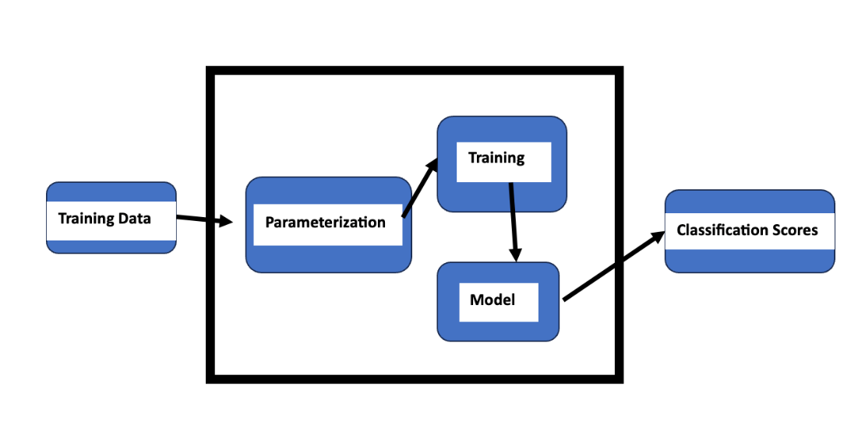
Machine learning

Slide 5
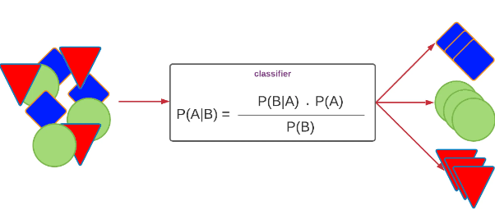
Naïve Bayes Classifier
Supervised Algorithm
Learns Incrementally
Does not need to be retrained on new data each time
Faster than existing methods database updates methods

Slide 6
Background
Semi-supervised learning may suffer from unexpected sequences in a dataset.
Classification of this unknown data is essential for:
Diagnosing Diseases
Environmental Monitoring
Vaccine Development
Taxonomic Classification of Microorganisms

Slide 7
Problem statement
Train a Naïve Bayes Classifier algorithm on select data and see how well it classifies unseen organisms based on how closely related it is to the training data.
Closeness to is to be determined by a threshold value given by the trained algorithm and use this value as reference to how well NBC recognizes unlabeled.

Slide 8
Materials and Methods
Materials:
Data → provided by Dr. Rosen
Picotte
Python
Methods:
Outlined in the following slides
By tasks provided

Slide 9
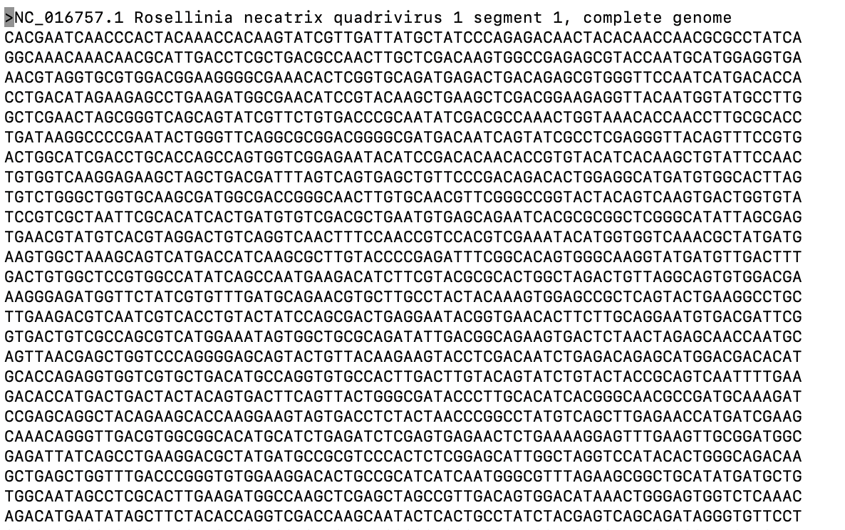
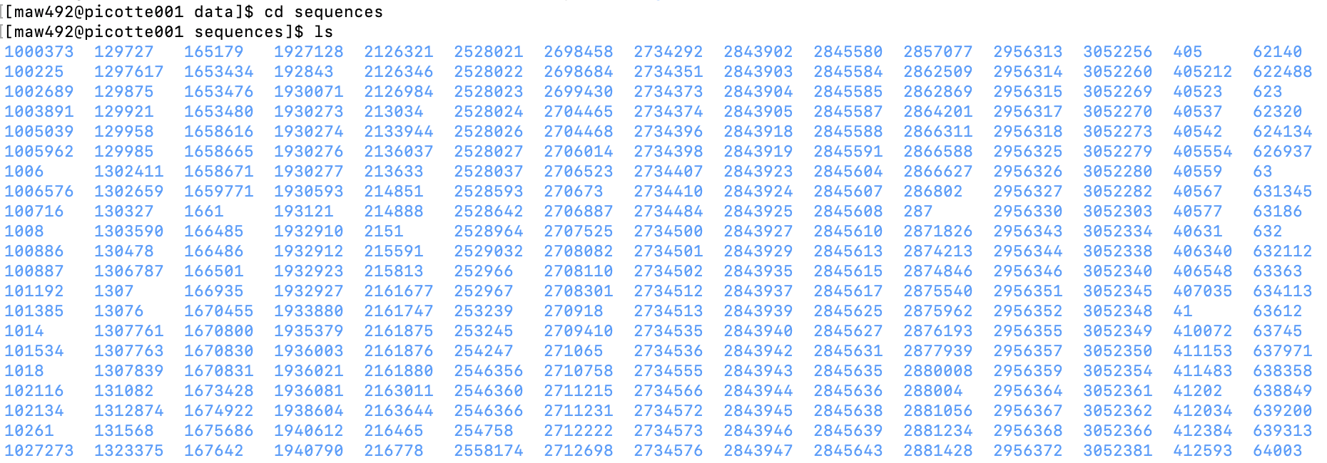
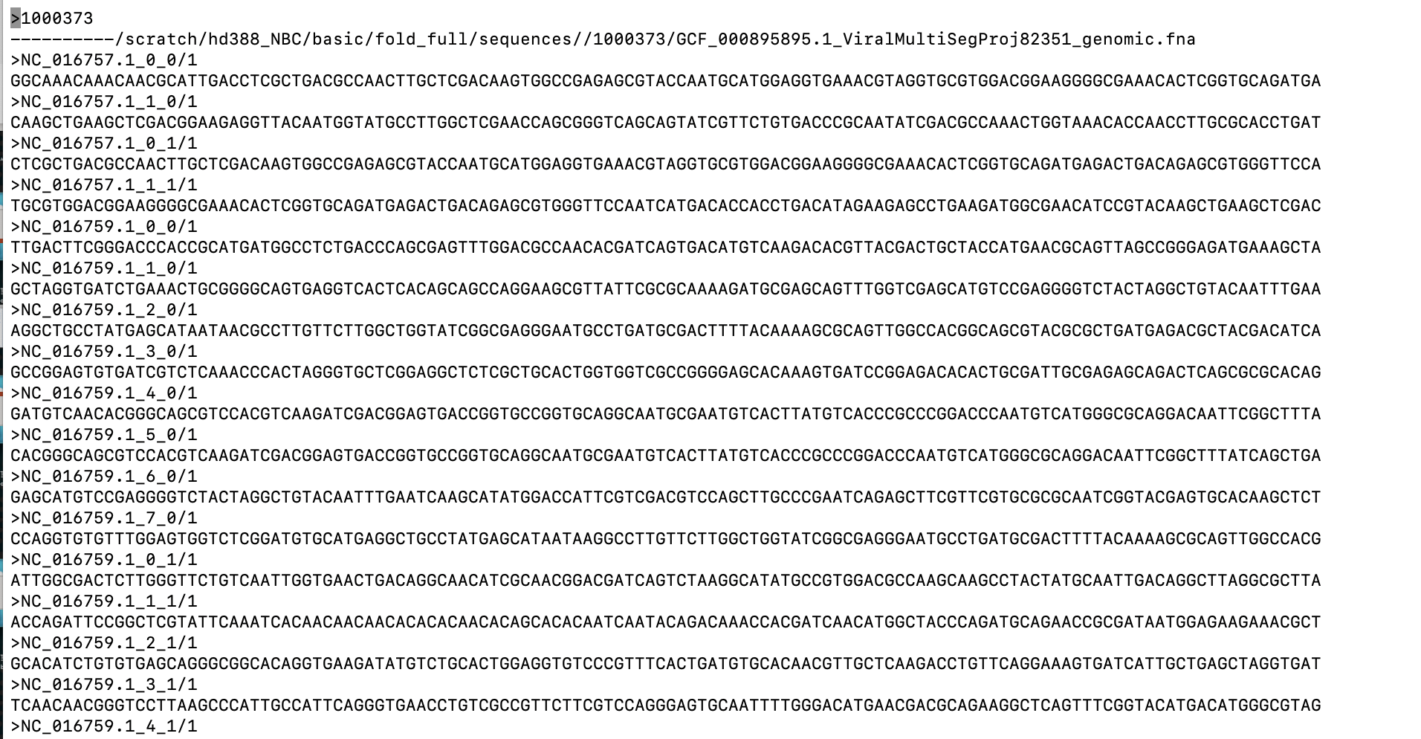
Results
Task 1: Understand the provided data sets and divide the training into 50/40/20%
Testing sequences file
Notes:
When opening the provided data there are two folders that we can look into. First is sequences and the other is testing_sequence. The sequences folder contains folders that are numbered and with each of those folders is a complete genome of a virus, bacteria, archaea or eukaryota. As pictured on the right. The testing sequence folder contains a subset of sequences that are all within one file.

Slide 10
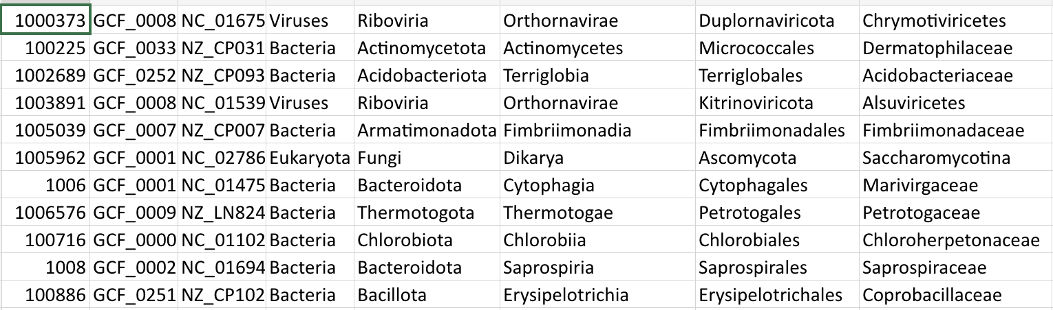
Results
Task 1: Understand the provided data sets and divide the training into 50/40/20%
To better code the division of training, we created a master file that linked all the folder numbers with the genomes

Slide 11
Results
Task 1: Understand the provided data sets and divide the training into 50/40/20%
Division of data
Called this half training
Full testing database
50%
Near: 10 sequences from the same taxa level
50%
Create a two testing sequences from what wasn't taken
Far: 10 sequences from the same taxa level above

Slide 12
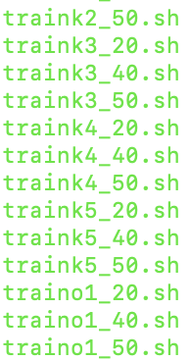
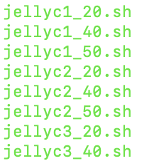
Results
Task 2: Run the training in the NBC program
Created jellyfish files for each training set
5 groups for each level of classification

Slide 13
Results
Task 3: Classify the created testing data based on the corresponding training

Slide 14
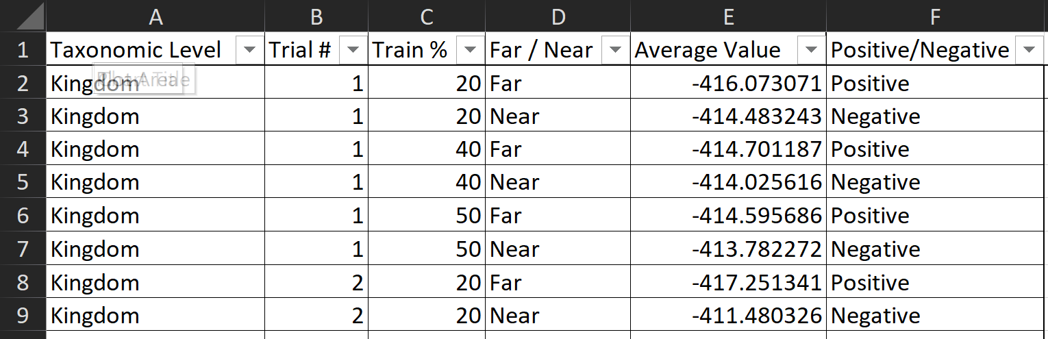
Results
Task 4: Extract and organize results

Slide 15
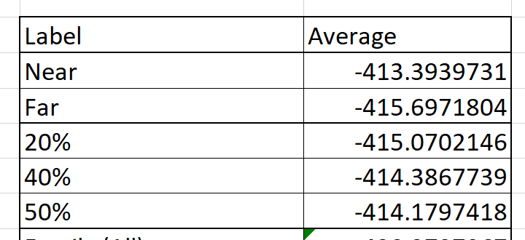
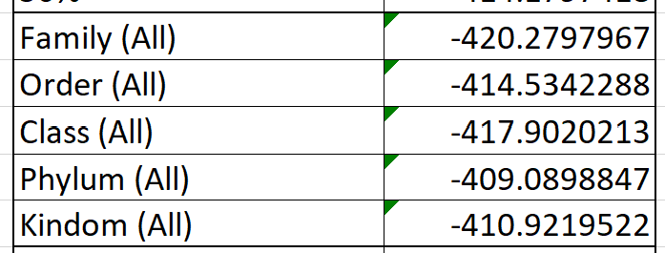
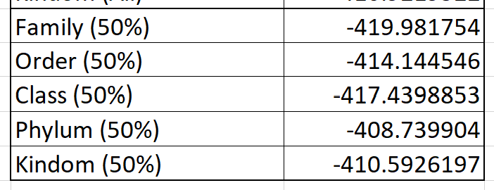
Results
Task 4: Extract and organize results

Slide 16
Results
Task 4: Extract and organize results

Slide 17
Results
Task 5: Compare the thresholds of the 50%, 40%, and 20% of the training data to see how the threshold changes

Slide 18
Discussion

Slide 19
Conclusion

Slide 20
References

